Slide 1
Cryptography (2021 Fall) public-key encryption, ElGamal encryption, plain RSA, digital signature
LiangFeng Zhang
zhanglf@shanghaitech.edu.cn
SIST, ShanghaiTech

Slide 2


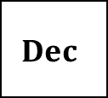


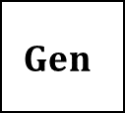

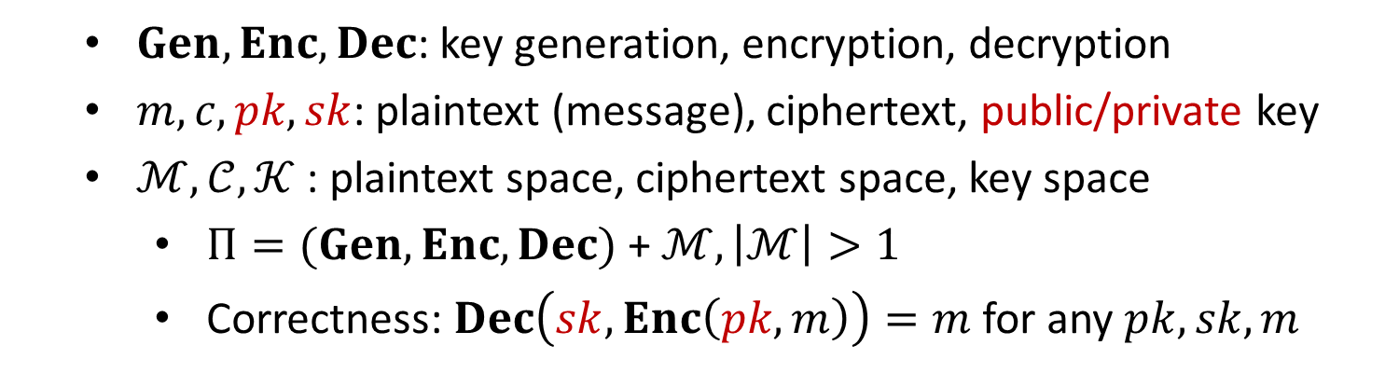
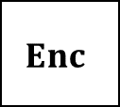


Public-Key Encryption
$$m$$
$$Enc$$
$$c←Enc(pk, m)$$
$$Dec$$
Alice
Bob
$$pk$$
$$sk$$
$$Dec(sk, c)=m$$
$$Gen$$
$Gen, Enc, Dec$: key generation, encryption, decryption
$m, c, pk,sk$: plaintext (message), ciphertext, public/private key
$ℳ,𝒞, 𝒦$ : plaintext space, ciphertext space, key space
$Π=(Gen, Enc, Dec)$ + $ℳ, \left|ℳ\right|>1$
Correctness: $Dec\left(sk,Enc\left(pk,m\right)\right)=m$ for any $pk,sk,m$

Slide 3
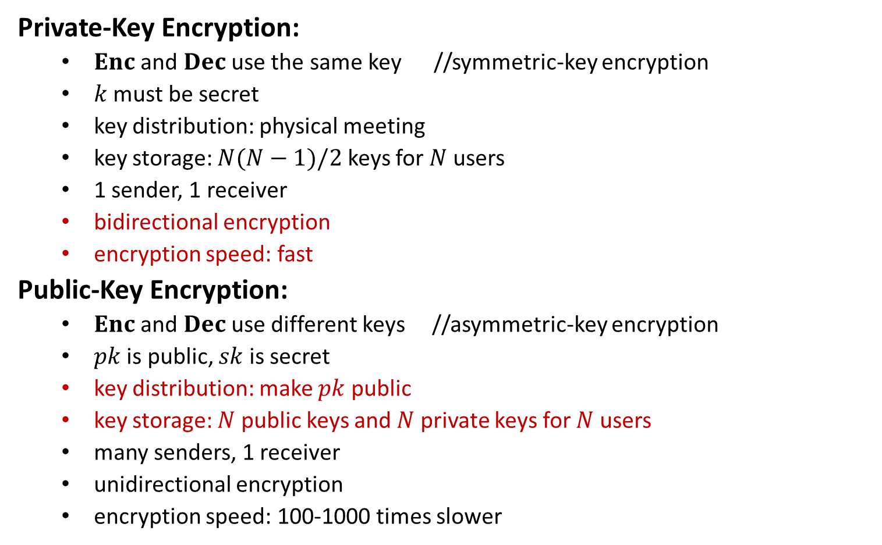
Comparisons
Private-Key Encryption:
$Enc$ and $Dec$ use the same key //symmetric-key encryption
$k$ must be secret
key distribution: physical meeting
key storage: $N(N−1)/2$ keys for $N$ users
1 sender, 1 receiver
bidirectional encryption
encryption speed: fast
Public-Key Encryption:
$Enc$ and $Dec$ use different keys //asymmetric-key encryption
$pk$ is public, $sk$ is secret
key distribution: make $pk$ public
key storage: $N$ public keys and $N$ private keys for $N$ users
many senders, 1 receiver
unidirectional encryption
encryption speed: 100-1000 times slower

Slide 5


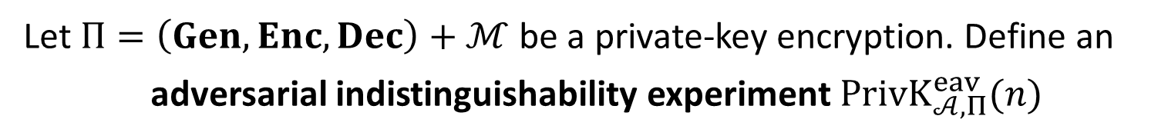



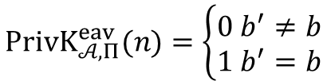


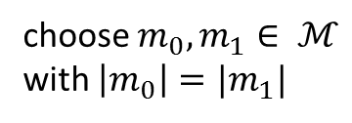

IND-EAV (PriKE)
Let $Π=\left(Gen, Enc, Dec\right)+ℳ$ be a private-key encryption. Define an
adversarial indistinguishability experiment $PrivK_{𝒜, Π}^{eav}(n)$
choose $m_{0}, m_{1}∈ ℳ$
with $\left|m_{0}\right|=|m_{1}|$
$$m_{0},m_{1}$$
$$k←Gen\left(1^{n}\right)$$
$$b←\{0,1\}$$
$$Challenger$$
$$c←Enc(k,m_{b})$$
$$Adversary 𝒜$$
$$c$$
$$b′$$
$$PrivK_{𝒜, Π}^{eav}(n)=\left\{\begin{aligned}0 b^{′}≠b \\ 1 b^{′}=b\end{aligned}\right.$$

Slide 6

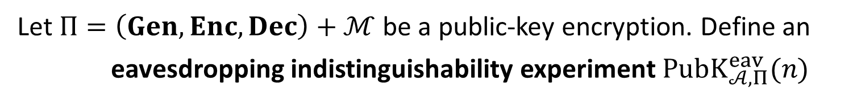


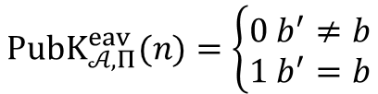

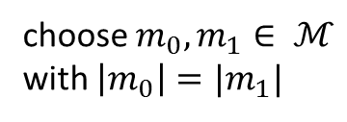

IND-EAV (PubKE)
Let $Π=\left(Gen, Enc, Dec\right)+ℳ$ be a public-key encryption. Define an
eavesdropping indistinguishability experiment $PubK_{𝒜, Π}^{eav}(n)$
$$(pk,sk)←Gen\left(1^{n}\right)$$
$$pk$$
choose $m_{0}, m_{1}∈ ℳ$
with $\left|m_{0}\right|=|m_{1}|$
$$m_{0},m_{1}$$
$$b←\{0,1\}$$
$$Challenger$$
$$c←Enc(pk,m_{b})$$
$$Adversary 𝒜$$
$$c$$
$$b′$$
$$PubK_{𝒜, Π}^{eav}(n)=\left\{\begin{aligned}0 b^{′}≠b \\ 1 b^{′}=b\end{aligned}\right.$$

Slide 7
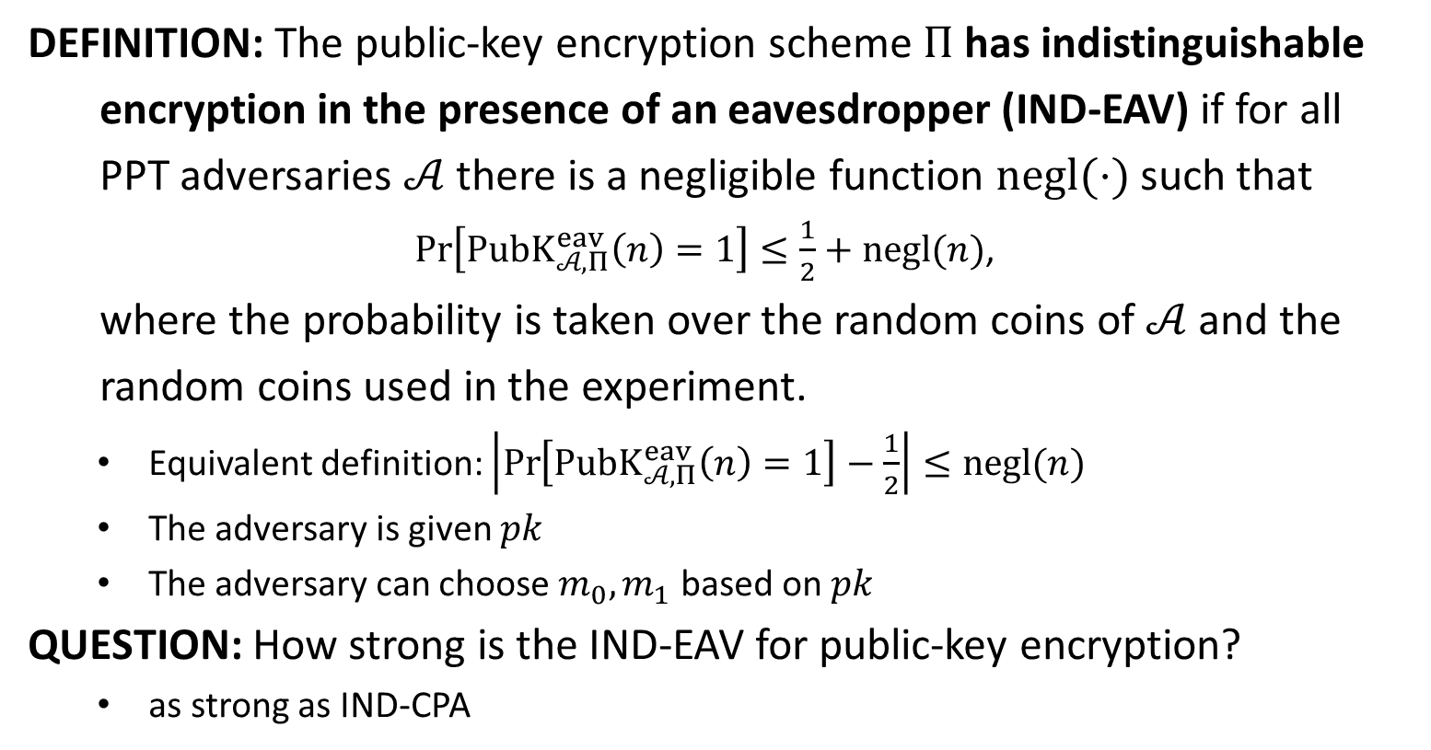
IND-EAV
DEFINITION: The public-key encryption scheme $Π$ has indistinguishable
encryption in the presence of an eavesdropper (IND-EAV) if for all
PPT adversaries $𝒜$ there is a negligible function $negl(⋅)$ such that
$\operatorname{Pr}\left[PubK_{𝒜, Π}^{eav}\left(n\right)=1\right]≤\frac{1}{2}+negl(n)$,
where the probability is taken over the random coins of $𝒜$ and the
random coins used in the experiment.
Equivalent definition: $\left|\operatorname{Pr}\left[PubK_{𝒜, Π}^{eav}\left(n\right)=1\right]−\frac{1}{2}\right|≤negl(n)$
The adversary is given $pk$
The adversary can choose $m_{0},m_{1}$ based on $pk$
QUESTION: How strong is the IND-EAV for public-key encryption?
as strong as IND-CPA

Slide 8


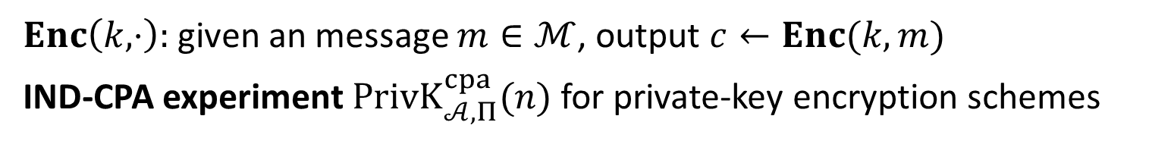










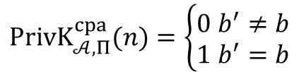

IND-CPA (PrivKE)
$Enc\left(k,⋅\right):$given an message $m∈ℳ$, output $c←Enc(k,m)$
IND-CPA experiment $PrivK_{𝒜, Π}^{cpa}(n)$ for private-key encryption schemes
$$k←Gen\left(1^{n}\right)$$
$$orace access to$$
$$Enc\left(k,⋅\right)$$
$$m_{0},m_{1}$$
$$\left|m_{0}\right|=|m_{1}|$$
$$Challenger$$
$$b←\{0,1\}$$
$$Adversary 𝒜$$
$$c←Enc(k,m_{b})$$
$$c$$
$$orace access to$$
$$Enc\left(k,⋅\right)$$
$$b′$$
$$PrivK_{𝒜, Π}^{cpa}(n)=\left\{\begin{aligned}0 b^{′}≠b \\ 1 b^{′}=b\end{aligned}\right.$$

Slide 9












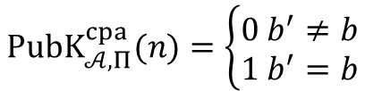

IND-CPA (PubKE)
IND-CPA experiment $PubK_{𝒜, Π}^{cpa}(n)$ for public-key encryption schemes
$$(pk,sk)←Gen\left(1^{n}\right)$$
$$pk$$
$$orace access to$$
$$Enc\left(pk,⋅\right)$$
$$m_{0},m_{1}$$
$$Challenger$$
$$\left|m_{0}\right|=|m_{1}|$$
$$Adversary 𝒜$$
$$b←\{0,1\}$$
$$c←Enc(pk,m_{b})$$
$$c$$
$$orace access to$$
$$Enc\left(pk,⋅\right)$$
$$b′$$
$$PubK_{𝒜, Π}^{cpa}(n)=\left\{\begin{aligned}0 b^{′}≠b \\ 1 b^{′}=b\end{aligned}\right.$$

Slide 10
IND-CPA (PubKE)
IND-CPA experiment $PubK_{𝒜, Π}^{cpa}(n)$ for public-key encryption schemes
$$(pk,sk)←Gen\left(1^{n}\right)$$
$$pk$$
$$m_{0},m_{1}$$
$$Challenger$$
$$\left|m_{0}\right|=|m_{1}|$$
$$Adversary 𝒜$$
$$b←\{0,1\}$$
$$c←Enc(pk,m_{b})$$
$$c$$
$$b′$$
$$PubK_{𝒜, Π}^{cpa}(n)=\left\{\begin{aligned}0 b^{′}≠b \\ 1 b^{′}=b\end{aligned}\right.$$

Slide 11
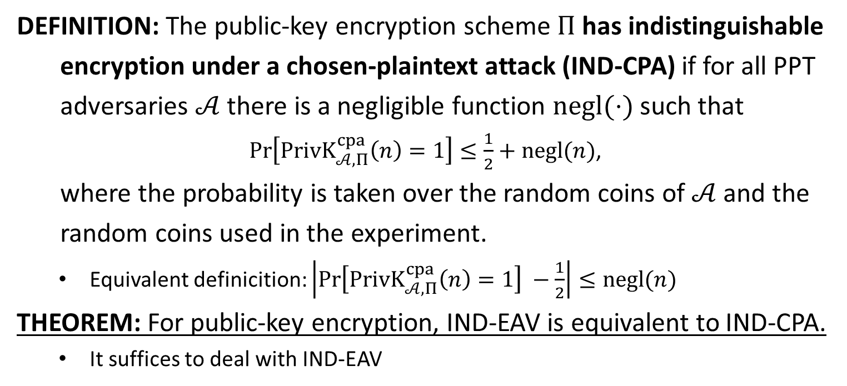
IND-CPA
DEFINITION: The public-key encryption scheme $Π$ has indistinguishable
encryption under a chosen-plaintext attack (IND-CPA) if for all PPT
adversaries $𝒜$ there is a negligible function $negl(⋅)$ such that
$\operatorname{Pr}\left[PrivK_{𝒜, Π}^{cpa}\left(n\right)=1\right]≤\frac{1}{2}+negl(n)$,
where the probability is taken over the random coins of $𝒜$ and the
random coins used in the experiment.
Equivalent definicition: $\left|\operatorname{Pr}\left[PrivK_{𝒜, Π}^{cpa}\left(n\right)=1\right] −\frac{1}{2}\right|≤negl(n)$
THEOREM: For public-key encryption, IND-EAV is equivalent to IND-CPA.
It suffices to deal with IND-EAV

Slide 12

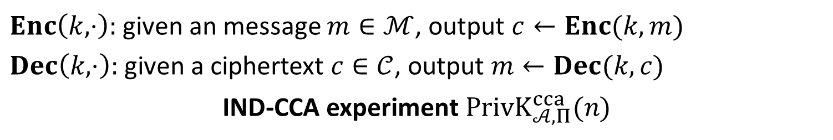









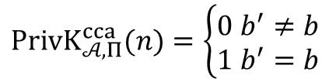

CCA (PrivKE)
$Enc\left(k,⋅\right):$given an message $m∈ℳ$, output $c←Enc(k,m)$
$Dec\left(k,⋅\right):$given a ciphertext $c∈𝒞$, output $m←Dec(k,c)$
IND-CCA experiment $PrivK_{𝒜, Π}^{cca}(n)$
$$k←Gen\left(1^{n}\right)$$
$$oracle access to$$
$$Enc\left(k,⋅\right), Dec(k,⋅)$$
$$m_{0},m_{1}$$
$$\left|m_{0}\right|=|m_{1}|$$
$$Challenger$$
$$b←\{0,1\}$$
$$Adversary 𝒜$$
$$c←Enc(k,m_{b})$$
$$c$$
$$oracle access to$$
$$Enc\left(k,⋅\right), Dec(k,⋅)$$
$$b′$$
$$PrivK_{𝒜, Π}^{cca}(n)=\left\{\begin{aligned}0 b^{′}≠b \\ 1 b^{′}=b\end{aligned}\right.$$

Slide 13



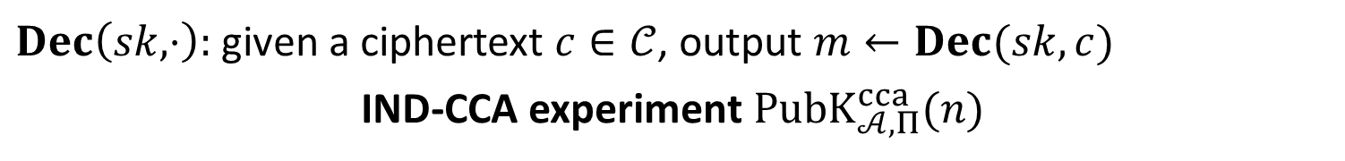









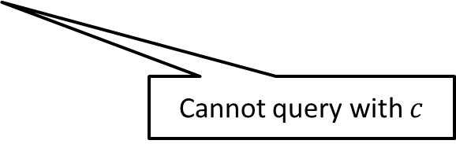

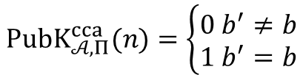

CCA (PubKE)
$Dec\left(sk,⋅\right):$given a ciphertext $c∈𝒞$, output $m←Dec(sk,c)$
IND-CCA experiment $PubK_{𝒜, Π}^{cca}(n)$
$$(pk,sk)←Gen\left(1^{n}\right)$$
$$pk$$
$$oracle access to$$
$$Dec(sk,⋅)$$
$$Challenger$$
$$m_{0},m_{1}$$
$$Adversary 𝒜$$
$$\left|m_{0}\right|=|m_{1}|$$
$$b←\{0,1\}$$
$$c←Enc(k,m_{b})$$
$$c$$
$$oracle access to$$
$$Dec(sk,⋅)$$
$$b′$$
$$PubK_{𝒜, Π}^{cca}(n)=\left\{\begin{aligned}0 b^{′}≠b \\ 1 b^{′}=b\end{aligned}\right.$$
Cannot query with $c$

Slide 14
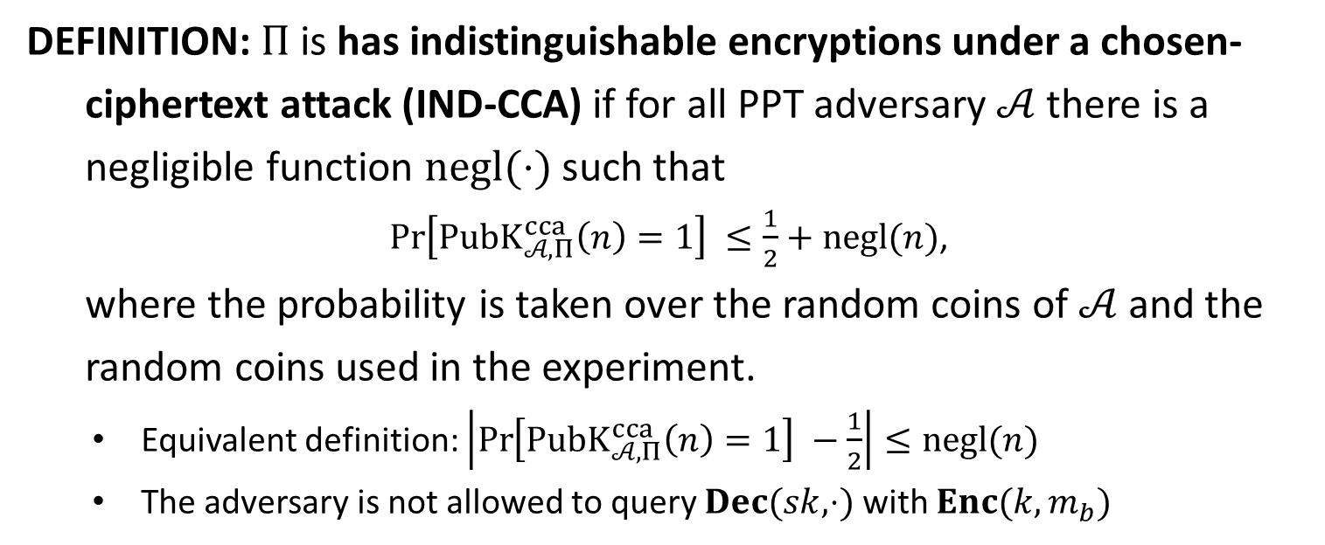
IND-CCA
DEFINITION: $Π$is has indistinguishable encryptions under a chosen-
ciphertext attack (IND-CCA) if for all PPT adversary $𝒜$ there is a
negligible function $negl(⋅)$ such that
$\operatorname{Pr}\left[PubK_{𝒜, Π}^{cca}\left(n\right)=1\right] ≤\frac{1}{2}+negl(n)$,
where the probability is taken over the random coins of $𝒜$ and the
random coins used in the experiment.
Equivalent definition: $\left|\operatorname{Pr}\left[PubK_{𝒜, Π}^{cca}\left(n\right)=1\right] −\frac{1}{2}\right|≤negl(n)$
The adversary is not allowed to query $Dec(sk,⋅)$ with $Enc(k,m_{b})$

Slide 16
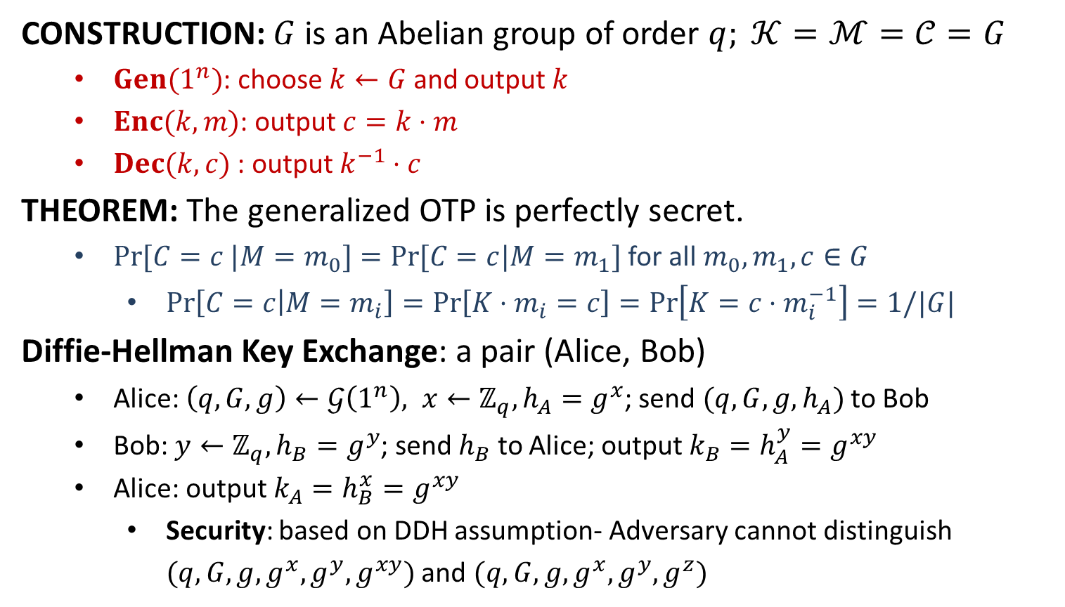
Generalized OTP
CONSTRUCTION: $G$ is an Abelian group of order $q; 𝒦=ℳ=𝒞=G$
$Gen(1^{n})$: choose $k←G$ and output $k$
$Enc(k,m)$: output $c=k⋅m$
$Dec(k,c)$ : output $k^{−1}⋅c$
THEOREM: The generalized OTP is perfectly secret.
$Pr⁡[C=c |M=m_{0}]=Pr⁡[C=c|M=m_{1}]$ for all $m_{0}, m_{1}, c∈G$
$\operatorname{Pr}\left[C=c | M=m_{i}\right]=\operatorname{Pr}\left[K⋅m_{i}=c\right]=\operatorname{Pr}\left[K=c⋅m_{i}^{−1}\right]=1/|G|$
Diffie-Hellman Key Exchange: a pair (Alice, Bob)
Alice: $\left(q,G,g\right)←𝒢\left(1^{n}\right), x←ℤ_{q}, h_{A}=g^{x}$; send $(q,G,g,h_{A})$ to Bob
Bob: $y←ℤ_{q}, h_{B}=g^{y}$; send $h_{B}$ to Alice; output $k_{B}=h_{A}^{y}=g^{xy}$
Alice: output $k_{A}=h_{B}^{x}=g^{xy}$
Security: based on DDH assumption- Adversary cannot distinguish $(q,G,g,g^{x},g^{y},g^{xy})$ and $(q,G,g,g^{x},g^{y},g^{z})$

Slide 17
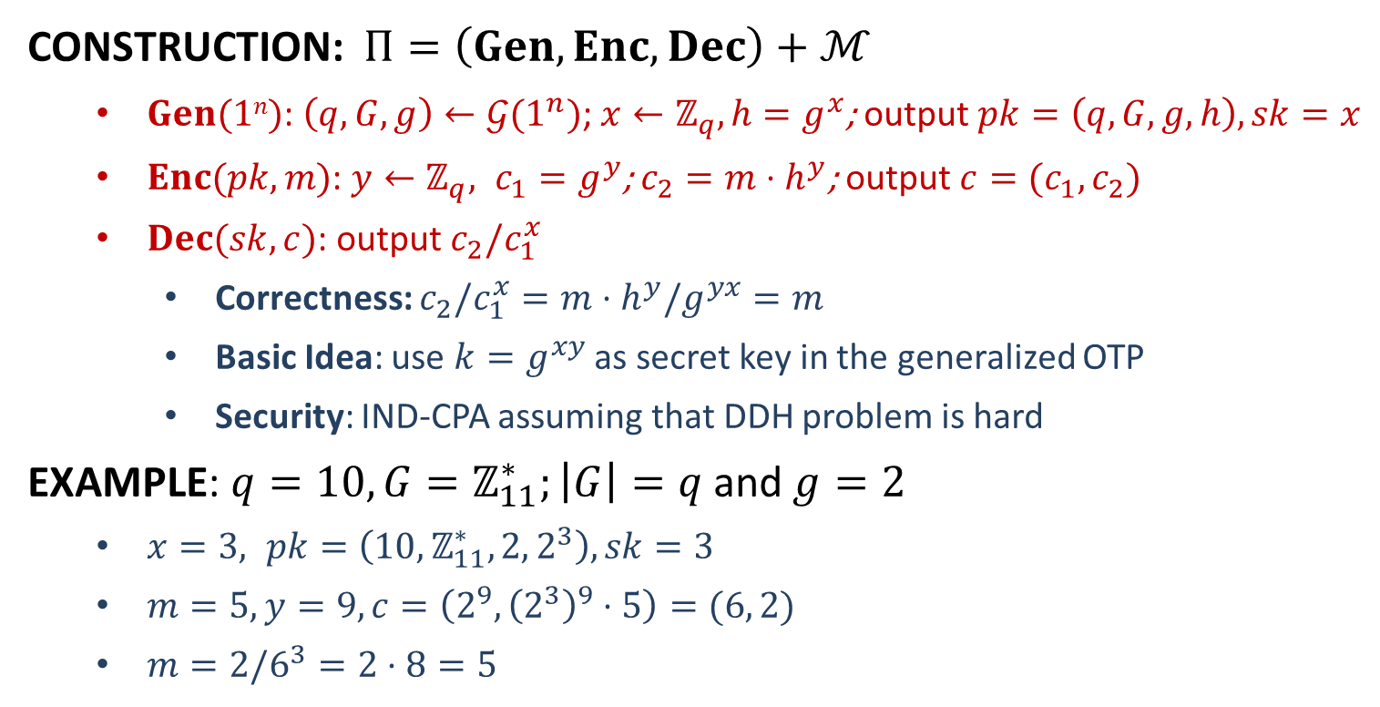
ElGamal Encryption
CONSTRUCTION: $Π=\left(Gen,Enc,Dec\right)+ℳ$
$Gen(1n)$: $\left(q,G,g\right)←𝒢(1^{n})$; $x←ℤ_{q}, h=g^{x}$; output $pk=\left(q,G,g,h\right), sk=x$
$Enc(pk, m)$: $y←ℤ_{q}, c_{1}=g^{y}$; $c_{2}=m⋅h^{y}$; output $c=(c_{1},c_{2})$
$Dec(sk, c)$: output $c_{2}/c_{1}^{x}$
Correctness: $c_{2}/c_{1}^{x}=m⋅h^{y}/g^{yx}=m$
Basic Idea: use $k=g^{xy}$ as secret key in the generalized OTP
Security: IND-CPA assuming that DDH problem is hard
EXAMPLE: $q=10, G=ℤ_{11}^{∗};\left|G\right|=q$ and $g=2$
$x=3, pk=\left(10,ℤ_{11}^{∗},2, 2^{3}\right), sk=3$
$m=5, y=9, c=\left(2^{9}, {\left(2^{3}\right)}^{9}⋅5\right)=(6, 2)$
$m=2/6^{3}=2⋅8=5$

Slide 18


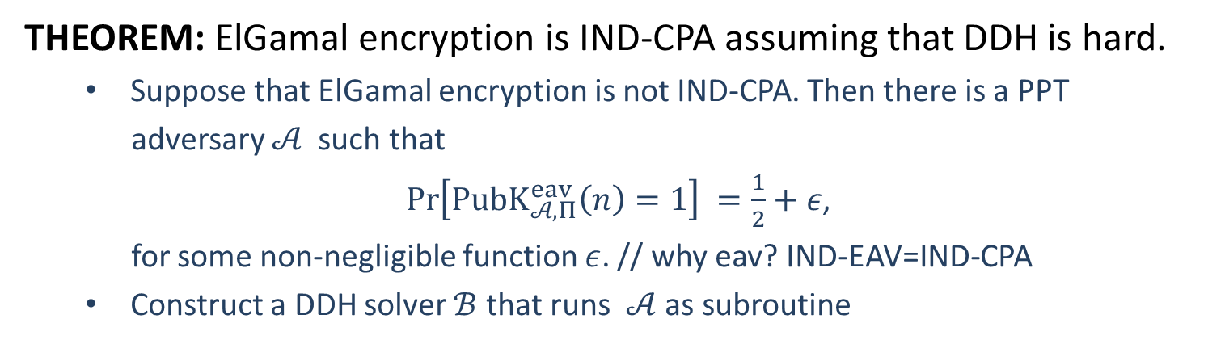





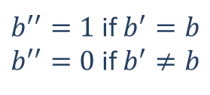

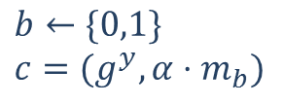

Security
THEOREM: ElGamal encryption is IND-CPA assuming that DDH is hard.
Suppose that ElGamal encryption is not IND-CPA. Then there is a PPT
adversary $𝒜$ such that
$\operatorname{Pr}\left[PubK_{𝒜, Π}^{eav}\left(n\right)=1\right] =\frac{1}{2}+ε$,
for some non-negligible function $ε$. // why eav? IND-EAV=IND-CPA
Construct a DDH solver $ℬ$ that runs $𝒜$ as subroutine
$$s=(q,G,g,g^{x},g^{y},α)$$
$α=g^{xy}$ or $α←G$
$$pk=(q,G,g,g^{x})$$
$$m_{0},m_{1}$$
$$b←\{0,1\}$$
$$c=(g^{y}, α⋅m_{b})$$
$$c$$
$$b′$$
$b^{′′}=1$ if $b^{′}=b$
$b^{′′}=0$ if $b^{′}≠b$
$$b^{′′}$$
$$ℬ$$
$$𝒜$$

Slide 19
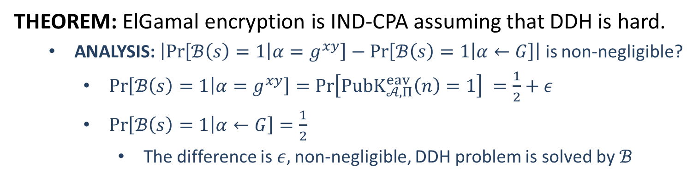
Security
THEOREM: ElGamal encryption is IND-CPA assuming that DDH is hard.
ANALYSIS: $\left|\operatorname{Pr}\left[ℬ\left(s\right)=1 | α=g^{xy}\right]−\operatorname{Pr}\left[ℬ\left(s\right)=1 | α←G\right]\right|$ is non-negligible?
$\operatorname{Pr}\left[ℬ\left(s\right)=1 | α=g^{xy}\right]=\operatorname{Pr}\left[PubK_{𝒜, Π}^{eav}\left(n\right)=1\right] =\frac{1}{2}+ε$
$\operatorname{Pr}\left[ℬ\left(s\right)=1 | α←G\right]=\frac{1}{2}$
The difference is $ε,$non-negligible, DDH problem is solved by $ℬ$
$$s=(q,G,g,g^{x},g^{y},α)$$
$α=g^{xy}$ or $α←G$
$$pk=(q,G,g,g^{x})$$
$$m_{0},m_{1}$$
$$b←\{0,1\}$$
$$c=(g^{y}, α⋅m_{b})$$
$$c$$
$$b′$$
$b^{′′}=1$ if $b^{′}=b$
$b^{′′}=0$ if $b^{′}≠b$
$$b^{′′}$$
$$ℬ$$
$$𝒜$$

Slide 21
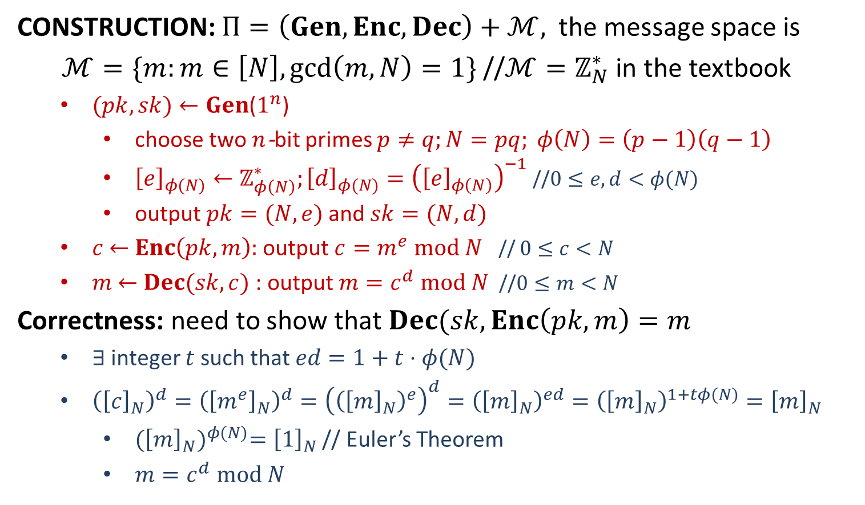
Plain RSA
CONSTRUCTION: $Π=\left(Gen,Enc,Dec\right)+ℳ,$the message space is
$ℳ=\{m:m∈\left[N\right],\gcd\left(m,N\right)=1\}$ //$ℳ=ℤ_{N}^{∗}$ in the textbook
$(pk, sk)←Gen$($1^{n}$)
choose two $n$-bit primes $p≠q;N=pq; φ\left(N\right)=\left(p−1\right)\left(q−1\right)$
${\left[e\right]}_{φ(N)}←ℤ_{φ\left(N\right)}^{∗};{\left[d\right]}_{φ(N)}={\left({\left[e\right]}_{φ\left(N\right)}\right)}^{−1}$//$0≤e, d<φ(N)$
output $pk=(N, e)$and $sk=(N, d)$
$c$ $←$ $Enc\left(pk, m\right):$ output $c=m^{e} mod N$ // $0≤c<N$
$m$ $←$ $Dec(sk, c)$ : output $m=c^{d} mod N$ //$0≤m<N$
Correctness: need to show that $Dec(sk, Enc\left(pk,m\right)=m$
$∃$ integer $t$ such that $ed=1+t⋅φ(N)$
${\left({\left[c\right]}_{N}\right)}^{d}={\left({\left[m^{e}\right]}_{N}\right)}^{d}={\left({\left({\left[m\right]}_{N}\right)}^{e}\right)}^{d}={\left({\left[m\right]}_{N}\right)}^{ed}={\left({\left[m\right]}_{N}\right)}^{1+tφ(N)}={\left[m\right]}_{N}$
${({\left[m\right]}_{N})}^{φ(N)}={\left[1\right]}_{N}$ // Euler’s Theorem
$m=c^{d} mod N$

Slide 22
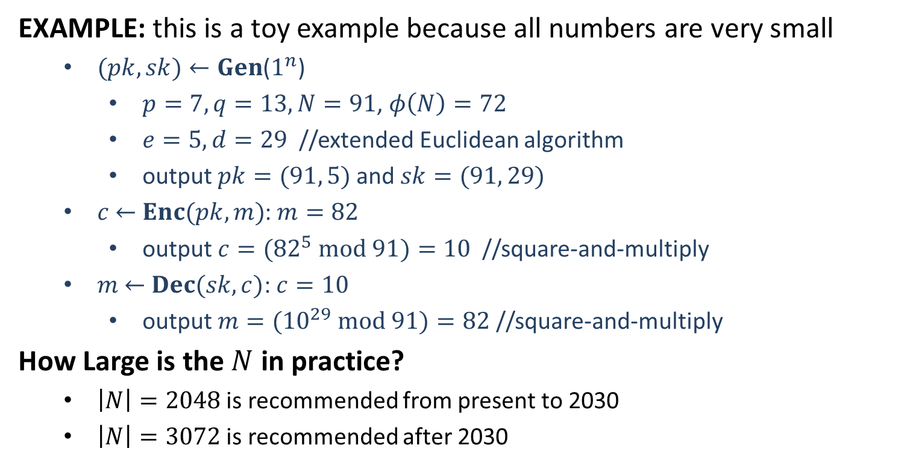
Plain RSA
EXAMPLE: this is a toy example because all numbers are very small
$(pk, sk)←Gen$($1^{n}$)
$p=7, q=13,N=91$, $φ\left(N\right)=72$
$e=5, d=29$ //extended Euclidean algorithm
output $pk=(91, 5)$and $sk=(91, 29)$
$c$ $←$ $Enc(pk, m)$: $m=82$
output $c=({82}^{5} mod 91)=10$ //square-and-multiply
$m$ $←$ $Dec(sk, c)$: $c=10$
output $m=({10}^{29} mod 91)=82$ //square-and-multiply
How Large is the $N$ in practice?
$\left|N\right|=2048$ is recommended from present to 2030
$\left|N\right|=3072$ is recommended after 2030

Slide 23


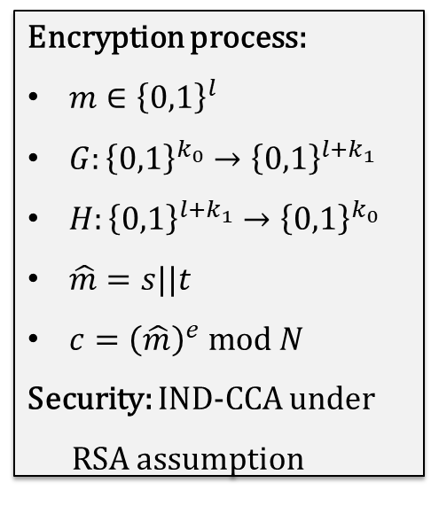
RSA-OAEP
RSA Optimal Asymmetric Encryption Padding: Variant of padded RSA,
part of the RSA PKCS #1 since version 2.0
Encryption process:
$m∈{\left\{0,1\right\}}^{l}$
$G:{\left\{0,1\right\}}^{k_{0}}→{\left\{0,1\right\}}^{l+k_{1}}$
$H:{\left\{0,1\right\}}^{l+k_{1}}→{\left\{0,1\right\}}^{k_{0}}$
$\hat{m}=s||t$
$c={\left(\hat{m}\right)}^{e} mod N$
Security: IND-CCA under
RSA assumption
$l+k_{1}$ bits
$k_{0}$ bits
RSA Assumption: Given $N,e$ and $y←ℤ_{N}^{∗}$, it is hard to learn $x∈ℤ_{N}^{∗}$ such that $x^{e}=y$.
THEOREM: RSA-OAEP is IND-CCA secure under the RSA assumption.

Slide 25
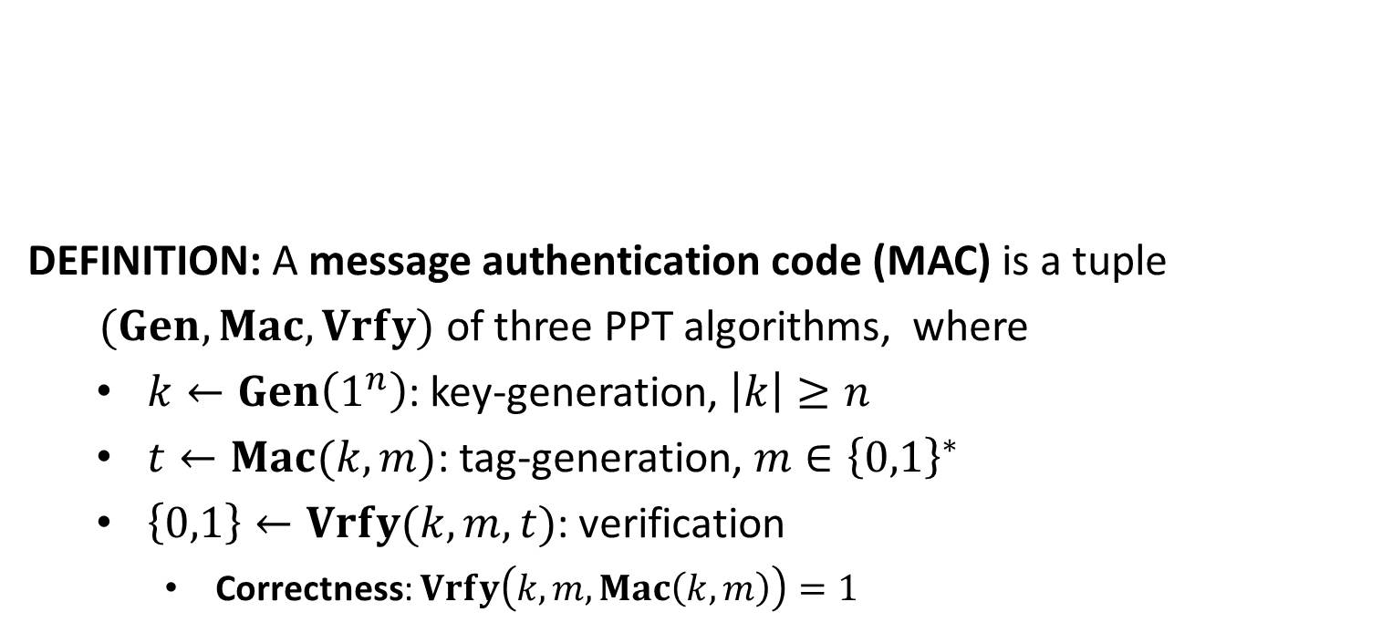




Message Authentication Code
DEFINITION: A message authentication code (MAC) is a tuple
$(Gen, Mac,Vrfy)$ of three PPT algorithms, where
$k←Gen\left(1^{n}\right)$: key-generation, $\left|k\right|≥n$
$t←Mac(k,m)$: tag-generation, $m∈{\left\{0,1\right\}}^{∗}$
$\left\{0,1\right\}←Vrfy(k,m,t)$: verification
Correctness: $Vrfy\left(k,m,Mac\left(k,m\right)\right)=1$
message $m$
tag $t$
$$k$$
$$k$$

Slide 26
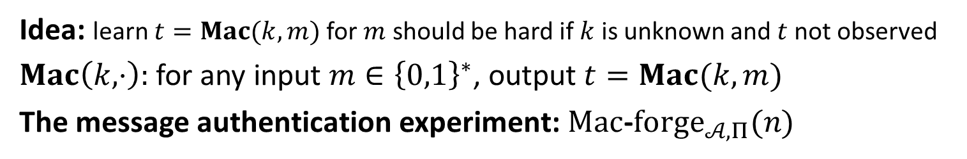

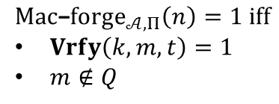





Security
Idea: learn $t=Mac(k,m)$ for $m$ should be hard if $k$ is unknown and $t$ not observed
$Mac\left(k,⋅\right):$ for any input $m∈{\left\{0,1\right\}}^{∗}$, output $t=Mac(k,m)$
The message authentication experiment: $Mac$-$forge_{𝒜,Π}(n)$
$$k←Gen\left(1^{n}\right)$$
$$oracle access to$$
$$Mac(k,⋅)$$
$$Challenger$$
$$Adversary 𝒜$$
$$(m,t)$$
$$Mac\text{−}forge_{𝒜,Π}\left(n\right)=1 iff$$
$Vrfy\left(k,m,t\right)=1$
$m∉Q$
$Q:$ the set of messages queried by $𝒜$

Slide 27
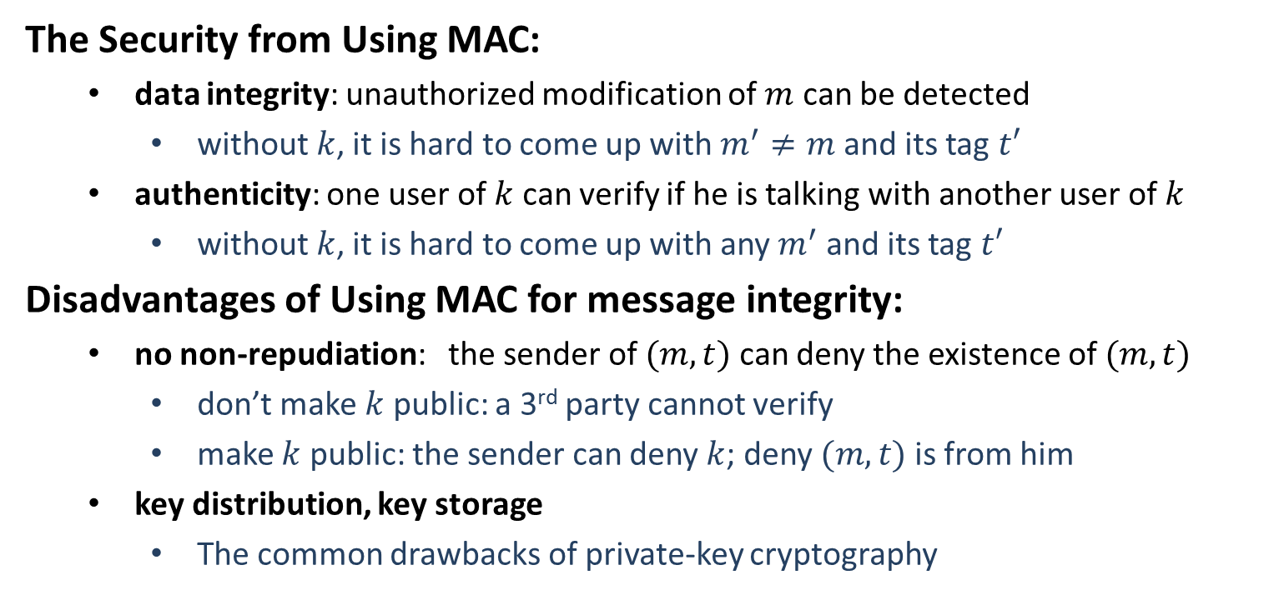
Security
The Security from Using MAC:
data integrity: unauthorized modification of $m$ can be detected
without$k$, it is hard to come up with $m^{′}≠m$ and its tag $t′$
authenticity: one user of $k$ can verify if he is talking with another user of $k$
without$k$, it is hard to come up with any $m^{′}$ and its tag $t′$
Disadvantages of Using MAC for message integrity:
no non-repudiation: the sender of $(m,t)$ can deny the existence of $(m,t)$
don’t make $k$ public: a 3rd party cannot verify
make $k$ public: the sender can deny $k$; deny $(m,t)$ is from him
key distribution, key storage
The common drawbacks of private-key cryptography

Slide 28

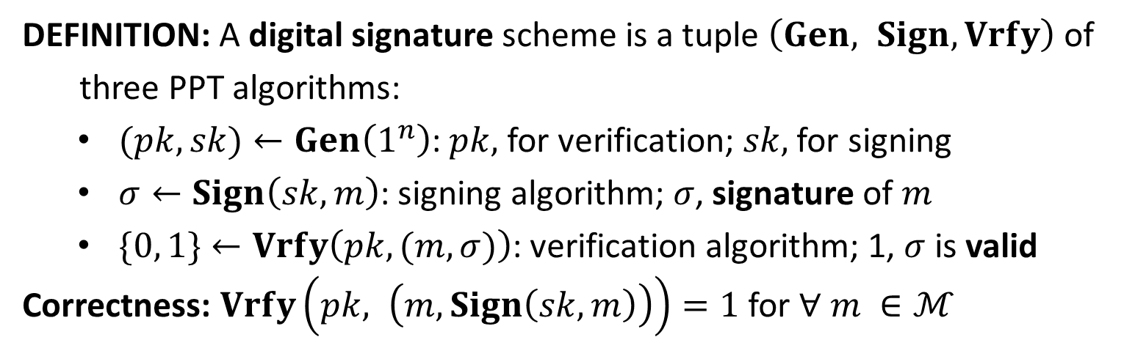


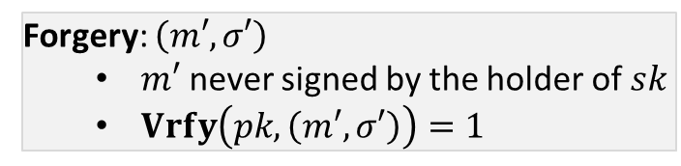


Digital Signature
DEFINITION: A digital signature scheme is a tuple $\left(Gen, Sign, Vrfy\right)$ of
three PPT algorithms:
$(pk,sk)←Gen\left(1^{n}\right)$: $pk,$ for verification; $sk,$ for signing
$σ←Sign\left(sk, m\right)$: signing algorithm; $σ$, signature of $m$
$\{0, 1\}←Vrfy\left(pk, (m,σ)\right)$: verification algorithm; 1, $σ$ is valid
Correctness: $Vrfy\left(pk, \left(m, Sign\left(sk,m\right)\right)\right)=1$ for $∀ m ∈ℳ$
$$(m, σ)$$
$$(m′, σ′)$$
$$?Vrfy\left(pk, \left(m, σ\right)\right)=1$$
Alice
Bob
Forgery: $\left(m′, σ′\right)$
$m′$ never signed by the holder of $sk$
$Vrfy\left(pk, \left(m′, σ′\right)\right)=1$
$$sk$$
A
$$pk$$

Slide 29






Security
The Signature Experiment $Sig−forge_{𝒜,Π}(n)$
$$(pk,sk)←Gen\left(1^{n}\right)$$
$$pk$$
$$orace access to$$
$$Challenger$$
$$Sign(sk,⋅)$$
$$Adversary 𝒜$$
$$(m,σ)$$
$$output 1 if and only if$$
$m never signed with sk$
$Vrfy\left(pk,\left(m,σ\right)\right)=1$

Slide 30
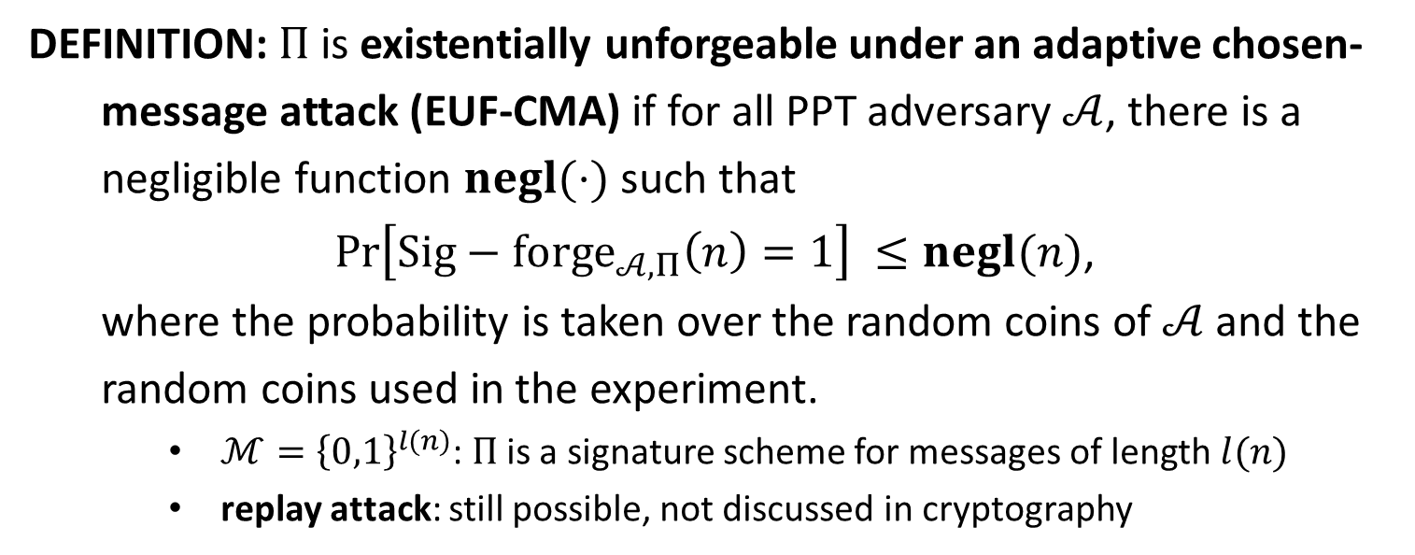
EUF-CMA
DEFINITION: $Π$is existentially unforgeable under an adaptive chosen-
message attack (EUF-CMA) if for all PPT adversary $𝒜$, there is a
negligible function $negl(⋅)$ such that
$\operatorname{Pr}\left[Sig−forge_{𝒜,Π}\left(n\right)=1\right] ≤negl(n)$,
where the probability is taken over the random coins of $𝒜$ and the
random coins used in the experiment.
$ℳ={\left\{0,1\right\}}^{l(n)}$: $Π$ is a signature scheme for messages of length $l(n)$
replay attack: still possible, not discussed in cryptography

